Slide 1
Chapter 10: Memory Interface

Slide 2
Introduction
Simple or complex, every microprocessor-based system has a memory system.
Almost all systems contain two main types of memory: read-only memory (ROM) and random access memory (RAM) or read/write memory.
This chapter explains how to interface both memory types to the Intel family of microprocessors.

Slide 3
Chapter Objectives
Upon completion of this chapter, you will be able to:
Decode the memory address and use the outputs of the decoder to select various memory components.
Use programmable logic devices (PLDs) to decode memory addresses.
Explain how to interface both RAM and ROM to a microprocessor.

Slide 4
Chapter Objectives
(cont.)
Upon completion of this chapter, you will be able to:
Explain how error correction code (ECC)
is used with memory.
Interface memory to an 8-, 16-, 32-, and
64-bit data bus.
Explain the operation of a dynamic RAM controller.
Interface dynamic RAM to the microprocessor.

Slide 5
10–1 MEMORY DEVICES
Before attempting to interface memory to the microprocessor, it is essential to understand the operation of memory components.
In this section, we explain functions of the
four common types of memory:
  Read-only memory (ROM)
  Flash memory (EEPROM)
  Static random access memory (SRAM)
  Dynamic random access memory (DRAM)

Slide 6
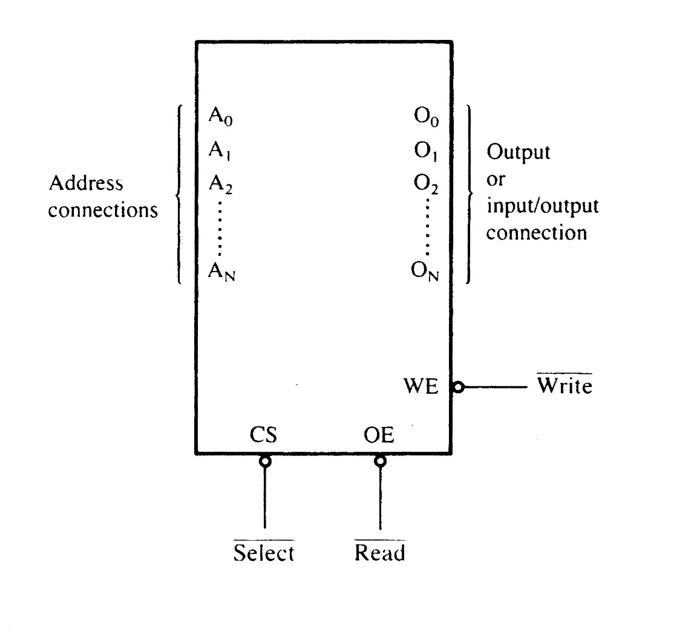
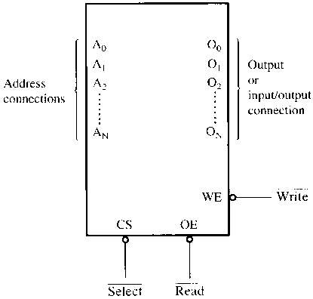
Figure 10–1 A pseudo memory component illustrating the address, data, and control connections.
Memory Pin Connections
  address inputs
  data outputs or input/outputs
  some type of selection input
  at least one control input to select a read or write operation

Slide 7
Address Connections
Memory devices have address inputs to
select a memory location within the device.
Almost always labeled from A₀, the least significant address input, to A_{n}
  where subscript n can be any value
  always labeled as one less than total number
  of address pins
A memory device with 10 address pins has
its address pins labeled from A₀ to A₉.

Slide 8
Address Space (Main Memory: RAM)
Address bus:10 bit →Address Space:1 Kbytes (2¹⁰)
Address bus:11 bit →Address Space:2 Kbytes (2¹¹)
Address bus:16 bit →Address Space:64 KBytes (2¹⁶)
Address bus:20 bit →Address Space:1 MBytes Address bus:32 bit →Address Space:4 GBytes Address bus:34 bit →Address Space:16GBytes
Address bus:36 bit →Address Space:64GBytes
Address bus:38 bit →Address Space:256GBytes
Address bus:52 bit →Address Space:10⁵² Bytes

Slide 9
The number of address pins on a memory device is determined by the number of memory locations found within it.
Today, common memory devices have between 1K (1024) to 1G (1,073,741,824) memory locations.
  with 4G and larger devices on the horizon
A 1K memory device has 10 address pins.
  therefore, 10 address inputs are required to
  select any of its 1024 memory locations

Slide 10
It takes a 10-bit binary number to select any single location on a 1024-location device.
  1024 different combinations
  if a device has 11 address connections, it
  has 2048 (2K) internal memory locations
The number of memory locations can be extrapolated from the number of pins.

Slide 11
Data Connections
All memory devices have a set of data
outputs or input/outputs.
  today, many devices have bidirectional
  common I/O pins
  data connections are points at which data are entered for storage or extracted for reading
Data pins on memory devices are labeled D₀ through D₇ for an 8-bit-wide memory device.

Slide 12
An 8-bit-wide memory device is often called a byte-wide memory.
  most devices are currently 8 bits wide,
  some are 16 bits, 4 bits, or just 1 bit wide
Catalog listings of memory devices often refer to memory locations times bits per location.
  a memory device with 1K memory locations
  and 8 bits in each location is often listed as
  a 1K × 8 by the manufacturer
Memory devices are often classified according to total bit capacity.

Slide 13
Selection Connections
Each memory device has an input that selects or enables the memory device.
  sometimes more than one
This type of input is most often called a chip select (G2A) chip enable (CE) or simply select (S) input.
If more than one CE connection is present,
all must be activated to read or write data.

Slide 14
Control Connections
All memory devices have some form of control input or inputs.
  ROM usually has one control input, while RAM often has one or two control inputs
Control input often found on ROM is the output enable or gate connection, which allows data flow from output data pins.
The OE connection enables and disables a set of three-state buffers located in the device and must be active to read data.

Slide 15
RAM has either one or two control inputs.
  if one control input, it is often called R/W
If the RAM has two control inputs, they are usually labeled WE (or W ), and OE (or G ).
  write enable must be active to perform memory write, and OE active to perform a memory read
  when the two controls are present, they must never both be active at the same time
If both inputs are inactive, data are neither written nor read.
  the connections are at their high-impedance state

Slide 16
ROM Memory
Read-only memory (ROM) permanently stores programs/data resident to the system.
  and must not change when power disconnected
Often called nonvolatile memory, because its contents do not change even if power is disconnected.
A device we call a ROM is purchased in mass quantities from a manufacturer.
  programmed during fabrication at the factory

Slide 17
The EPROM (erasable programmable read-only memory) is commonly used when software must be changed often.
An EPROM is programmed in the field on a device called an EPROM programmer.
Also erasable if exposed to high-intensity ultraviolet light.
  depending on the type of EPROM

Slide 18
PROM memory devices are also available, although they are not as common today.
The PROM (programmable read-only memory) is also programmed in the field by burning open tiny NI-chrome or silicon oxide fuses.
Once it is programmed, it cannot be erased.

Slide 19
A newer type of read-mostly memory
(RMM) is called the flash memory.
  also often called an EEPROM (electrically erasable programmable ROM)
  EAROM (electrically alterable ROM)
  or a NOVRAM (nonvolatile RAM)
Electrically erasable in the system, but they require more time to erase than normal RAM.
The flash memory device is used to store setup information for systems such as the video card in the computer.

Slide 20
Flash has all but replaced the EPROM in most computer systems for the BIOS.
  some systems contain a password stored
  in the flash memory device
Flash memory has its biggest impact in memory cards for digital cameras and memory in MP3 audio players.
Figure 10–2 illustrates the 2716 EPROM, which is representative of most common EPROMs.

Slide 21
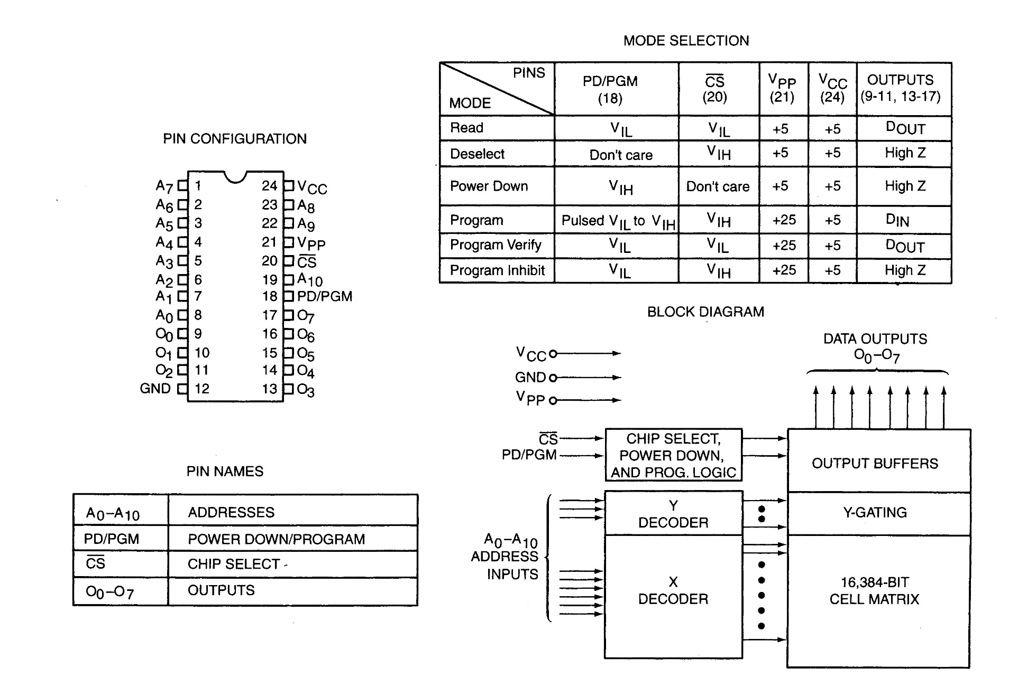
Figure 10–2 The pin-out of the 2716, 2K × 8 EPROM. (Courtesy of Intel Corporation.)

Slide 22
Figure 10–3 illustrates the timing diagram for the 2716 EPROM.
The V_{PP} pin must be placed at a logic 1 level for data to be read from the EPROM.
In some cases, the V_{PP} pin is in the same position as the WE pin on the SRAM.
This will allow a single socket to hold either
an EPROM or an SRAM.
  an example is the 27256 EPROM and 62256 SRAM, both 32K × 8 devices with the same pin-out, except for V_{PP} on the EPROM and WE on
  the SRAM.

Slide 23
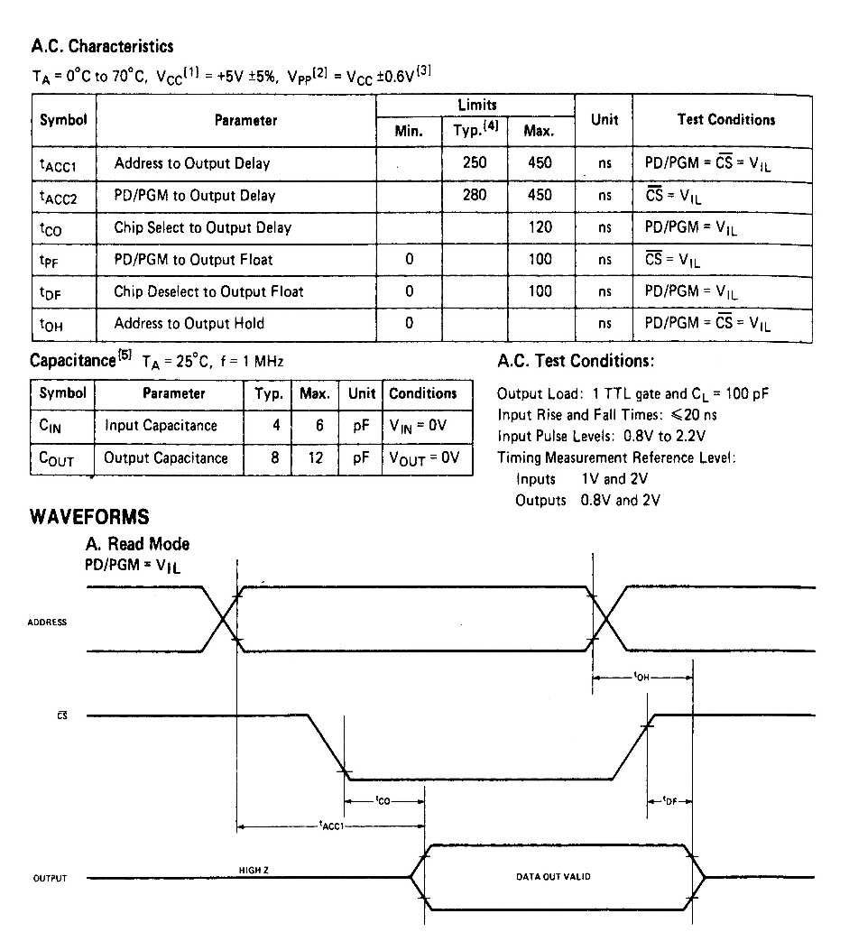
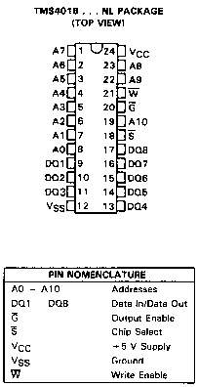
Figure 10–3 The timing diagram of AC characteristics of the 2716 EPROM. (Courtesy of Intel Corporation.)
  One important piece of information provided by the timing diagram and data sheet is the memory access time
  that is the time it takes the memory to read information

Slide 24
The basic speed of this EPROM is 450 ns.
  recall that 8086/8088 operated with a 5 MHz clock allowed memory 460 ns to access data
This type of component requires wait states
to operate properly with 8086/8088 because of its rather long access time.
  if wait states are not desired, higher-speed EPROMs are available at additional cost
  EPROM memory is available with access times
  of as little as 100 ns
Obviously, wait states are required in modern microprocessors for any EPROM device.

Slide 25
Static RAM (SRAM) Devices
Static RAM memory devices retain data for
as long as DC power is applied.
Because no special action is required to retain data, these devices are called static memory.
  also called volatile memory because they will
  not retain data without power
The main difference between ROM and RAM is that RAM is written under normal operation, whereas ROM is programmed outside the computer and normally is only read.

Slide 26
Fig 10–4 illustrates the 4016 SRAM,
  a 2K × 8 read/write memory
This device is representative of all SRAM devices.
  except for the number of address and data connections.
The control inputs of this RAM are slightly different from those presented earlier.
  however the control pins function exactly the same as those outlined previously
Found under part numbers 2016 and 6116.

Slide 27
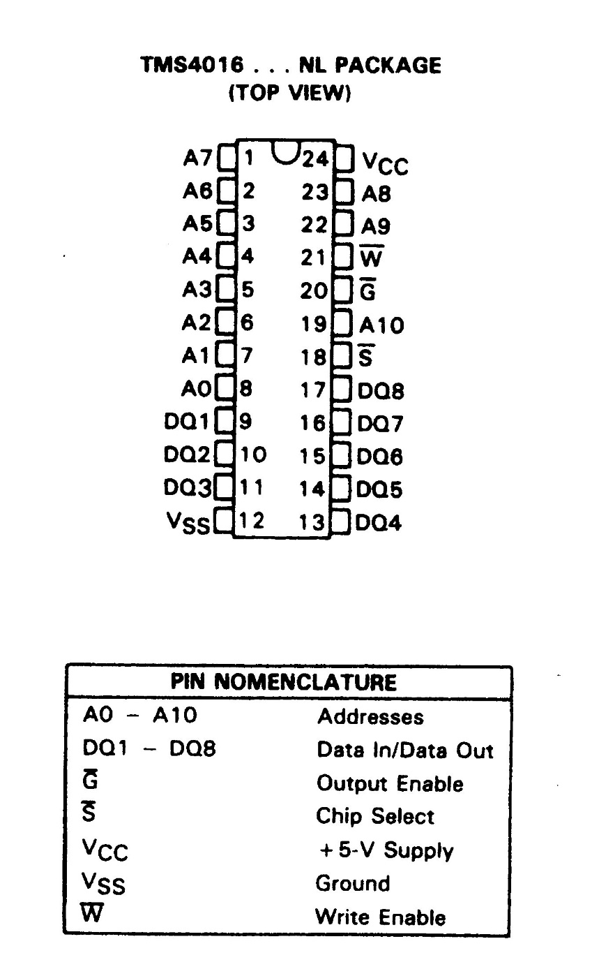
Figure 10–4 The pin-out of the TMS4016, 2K × 8 static RAM (SRAM). (Courtesy of Texas Instruments Incorporated.)
  SRAM is used when the size of the read/write memory is relatively small
  today, a small memory is less than 1M byte

Slide 28
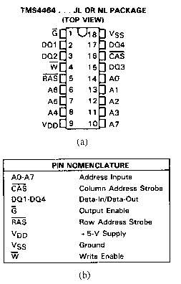
Figure 10–5 (a) The AC characteristics of the TMS4016 SRAM. (b) The timing diagrams of the TMS4016 SRAM. (Courtesy of Texas Instruments Incorporated.)
  the access time is t_{a(A)}
  on the slowest 4016, this time is 250 ns, fast enough to connect directly to an 8088/8086 at 5 MHz, without wait states
  access time must always be checked to determine compatibility of memory components

Slide 29
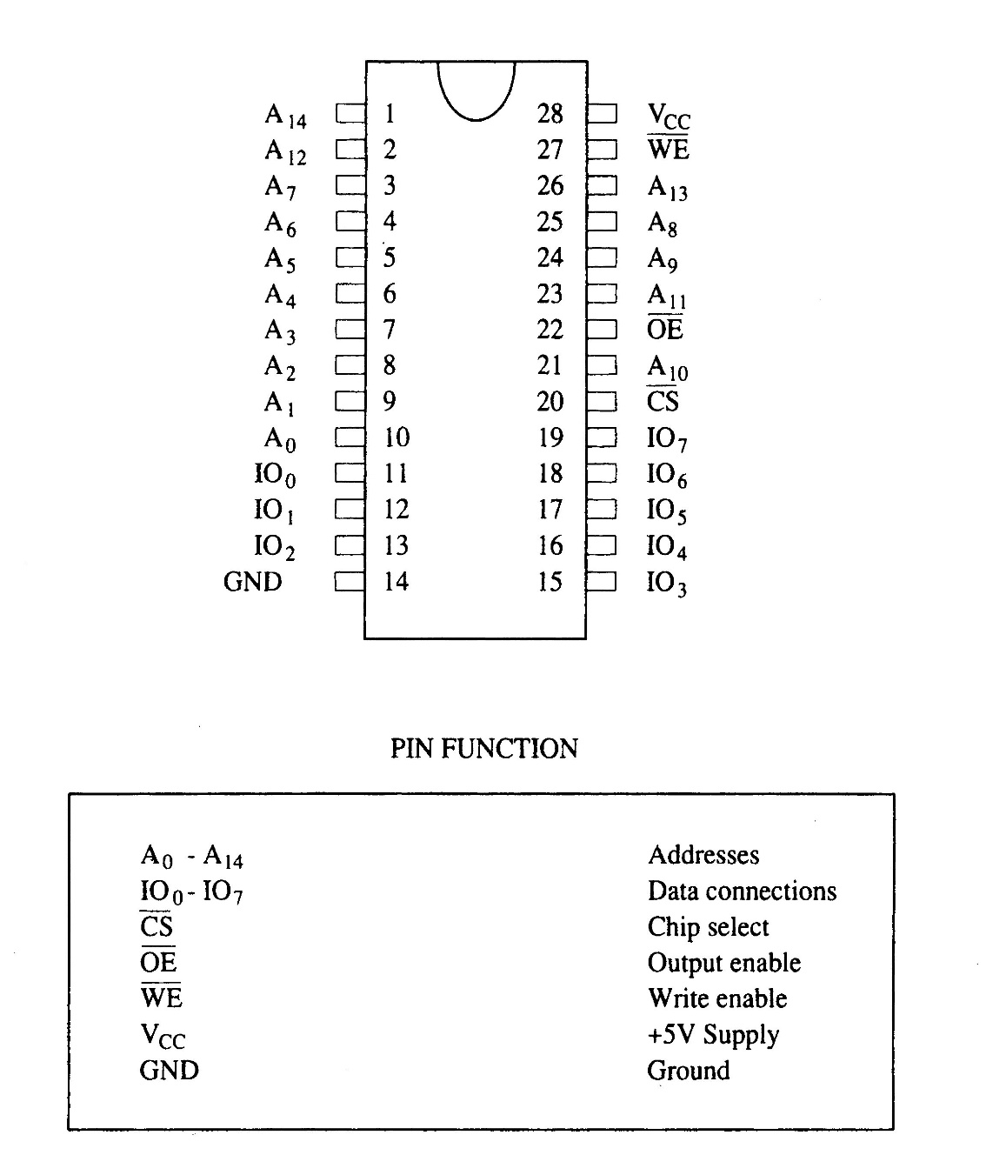
Figure 10–6 Pin diagram of the 62256, 32K × 8 static RAM.

Slide 30
Dynamic RAM (DRAM) Memory
Available up to 256M × 8 (2G bits).
DRAM is essentially the same as SRAM, except that it retains data for only 2 or 4 ms
on an integrated capacitor.
After 2 or 4 ms, the contents of the DRAM must be completely rewritten (refreshed).
  because the capacitors, which store a logic 1
  or logic 0, lose their charges

Slide 31
In DRAM, the entire contents are refreshed with 256 reads in a 2- or 4-ms interval.
  also occurs during a write, a read, or during a special refresh cycle
DRAM requires so many address pins that manufacturers multiplexed address inputs.
Figure 10–7 illustrates a 64K × 4 DRAM, the TMS4464, which stores 256K bits of data.
  note it contains only eight address inputs where
  it should contain 16—the number required to address 64K memory locations

Slide 32
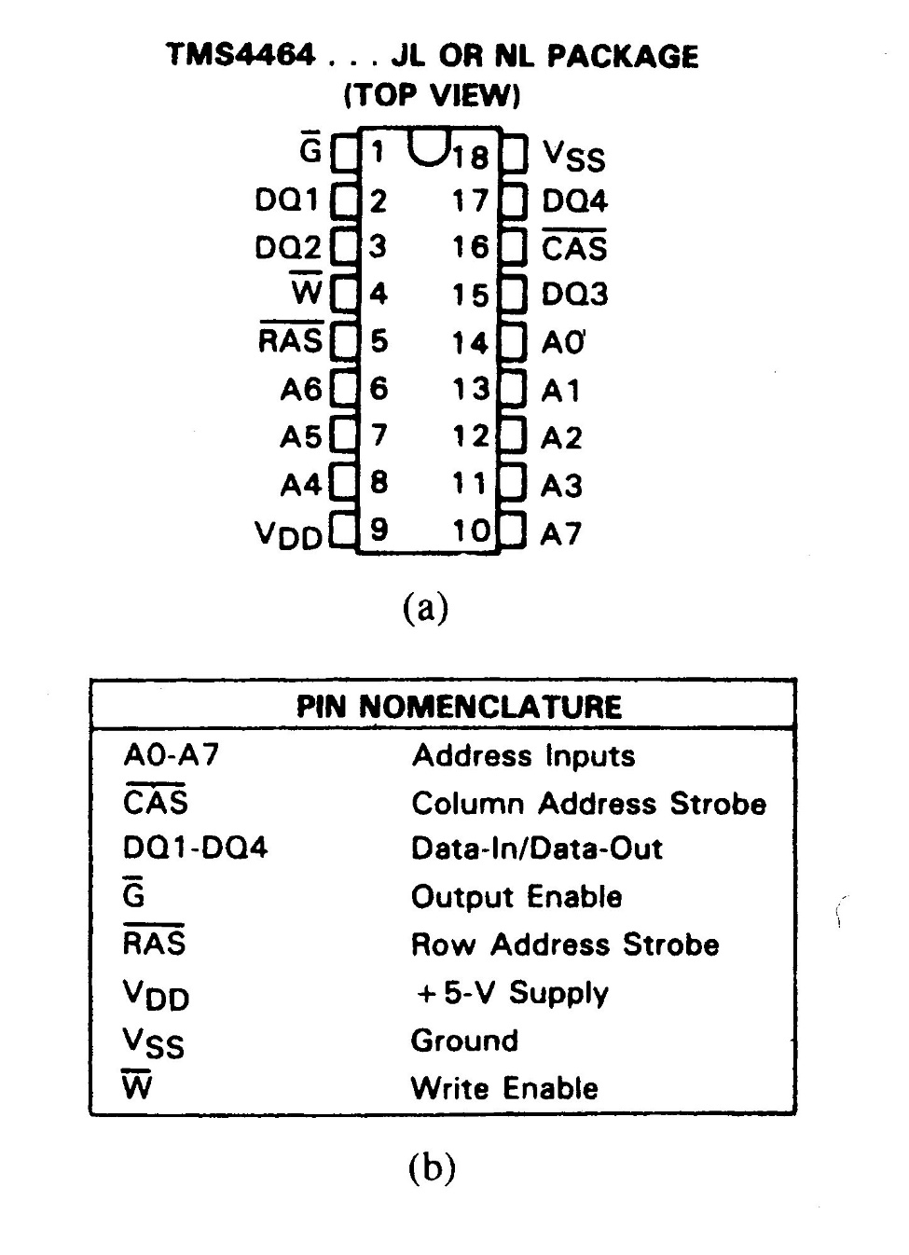
Figure 10–7 The pin-out of the TMS4464, 64K × 4 dynamic RAM (DRAM). (Courtesy of Texas Instruments Incorporated.)
  16 address bits can be forced into eight address pins in two 8-bit increments
  this requires two special pins: the column address strobe (CAS) and row address strobe (RAS)

Slide 33
10–4 8086, 80186, 80286, & 80386SX (16-Bit) MEMORY INTERFACE
8086, 80186, 80286, and 80386SX differ from the 8088/80188 in three ways:
  the data bus is 16 bits instead of 8 bits wide
  a new control signal called bus high enable

Slide 34
16-Bit Bus Control
The data bus of 8086, 80186, 80286, and 80386SX is twice as wide as for the 8088/80188.
  the wider bus presents a unique set of problems
  processors must be able to write data to any
  16-bit location—or any 8-bit location
This means the 16-bit data bus must be divided into two separate sections (or banks) 8 bits wide so that the processor can write to either half (8-bit) or both halves (16-bit).

Slide 35
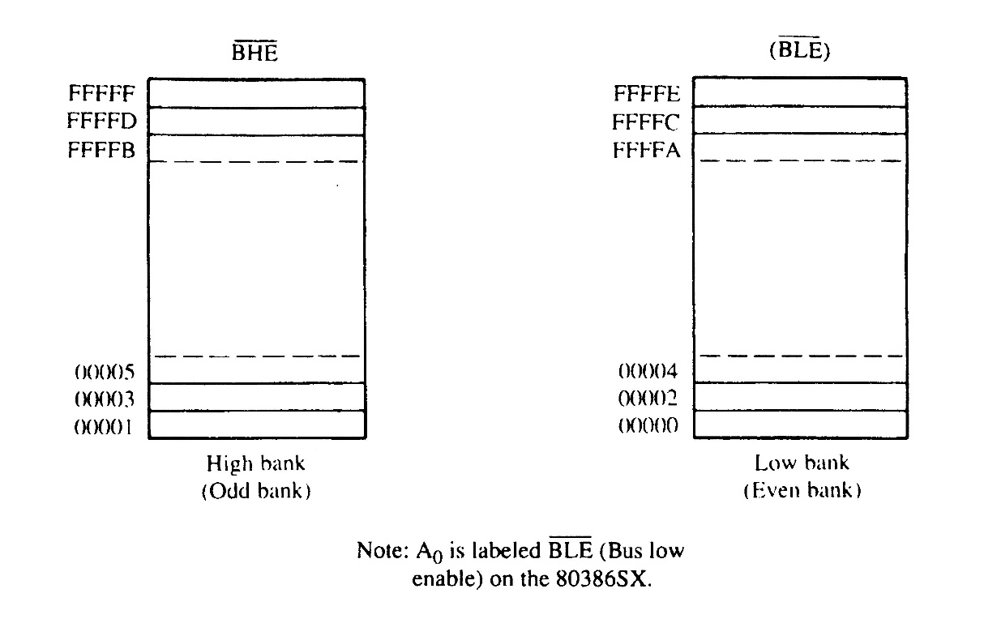
Figure 10–27 The high (odd) and low (even) 8-bit memory banks of the 8086/80286/80386SX microprocessors.
  one bank (low bank) holds all even-numbered memory locations
  the other bank (high bank) holds all the odd-numbered memory locations

Slide 36
Bank selection is accomplished in two ways:
  separate write signal is developed to select a write to each bank of the memory
  separate decoders are used for each bank
The first technique is by far the least costly approach to memory interface.
The second technique is only used in a system that must achieve the most efficient use of the power supply.

Slide 37
Separate Bank Write Strobes
The effective way to handle bank selection
is a separate write strobe for each bank.
  this requires only one decoder to select a 16-bit-wide memory, which saves money
Fig 10–29 depicts generation of separate
8086 write strobes.
Separate read strobes for each bank are usually unnecessary because 8086 through 80386SX read only the byte of data they need at any given time from half of the data bus.

Slide 38
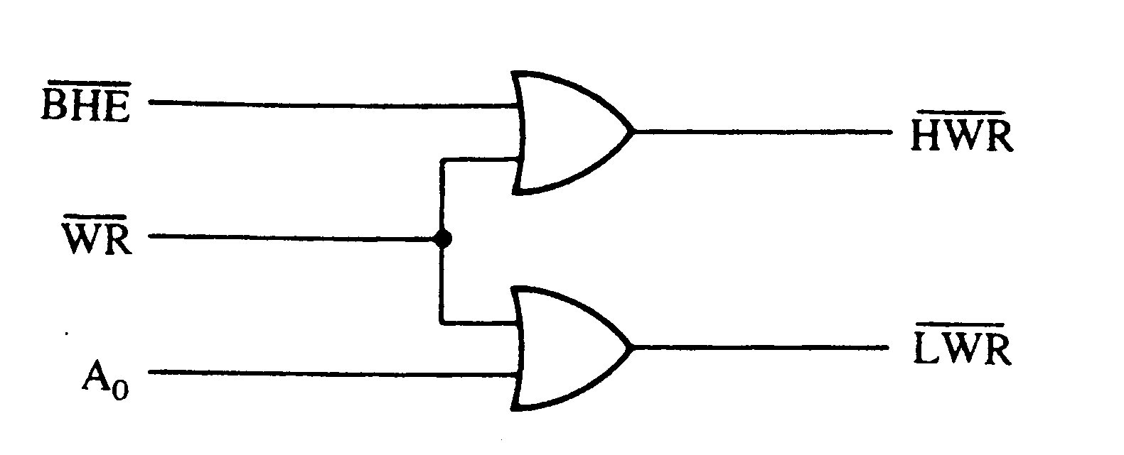
Figure 10–29 The memory bank write selection input signals: HWR (high bank write) and LWR (low bank write).
  a memory system that uses separate write strobes is constructed differently from the 8088 or the system using separate memory banks
  memory in a system using separate write strobes is decoded as 16-bit-wide

